Slide 1
COMBINATIONAL FUNCTIONAL DEVICES
DECODER-ENCODER
Notes:
‹#›

Slide 2
DECODER
ENCODER AND DECODER is used to convert the data from one form to another form.
DECODER is a digital circuit that detects the presence of a specified combination of bits(code) on it inputs and indicates the presence of that code by specified output level

Slide 3
DECODER
DECODER has n input lines and 2^{n} output lines
n 2^{n}

Slide 4
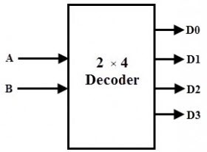
BLOCK DIAGRAM (Decoder 2x4)

Slide 5
TABLE
A | B | D0 | D1 | D2 | D3
0 | 0
0 | 1
1 | 0
1 | 1

Slide 6
TABLE
A | B | D0 | D1 | D2 | D3
0 | 0 | 1 | 0 | 0 | 0
0 | 1
1 | 0
1 | 1

Slide 7
TABLE
A | B | D0 | D1 | D2 | D3
0 | 0 | 1 | 0 | 0 | 0
0 | 1 | 0 | 1 | 0 | 0
1 | 0
1 | 1

Slide 8
TABLE
A | B | D0 | D1 | D2 | D3
0 | 0 | 1 | 0 | 0 | 0
0 | 1 | 0 | 1 | 0 | 0
1 | 0 | 0 | 0 | 1 | 0
1 | 1

Slide 9
TABLE
A | B | D0 | D1 | D2 | D3
0 | 0 | 1 | 0 | 0 | 0
0 | 1 | 0 | 1 | 0 | 0
1 | 0 | 0 | 0 | 1 | 0
1 | 1 | 0 | 0 | 0 | 1

Slide 10
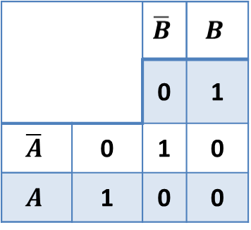
K-MAP & Expression
A | B | D0 | D1 | D2 | D3
0 | 0 | 1 | 0 | 0 | 0
0 | 1
1 | 0
1 | 1

Slide 11
TABLE
A | B | D0 | D1 | D2 | D3
0 | 0 | 1 | 0 | 0 | 0
0 | 1 | 0 | 1 | 0 | 0
1 | 0 | 0 | 0 | 1 | 0
1 | 1 | 0 | 0 | 0 | 1

Slide 12
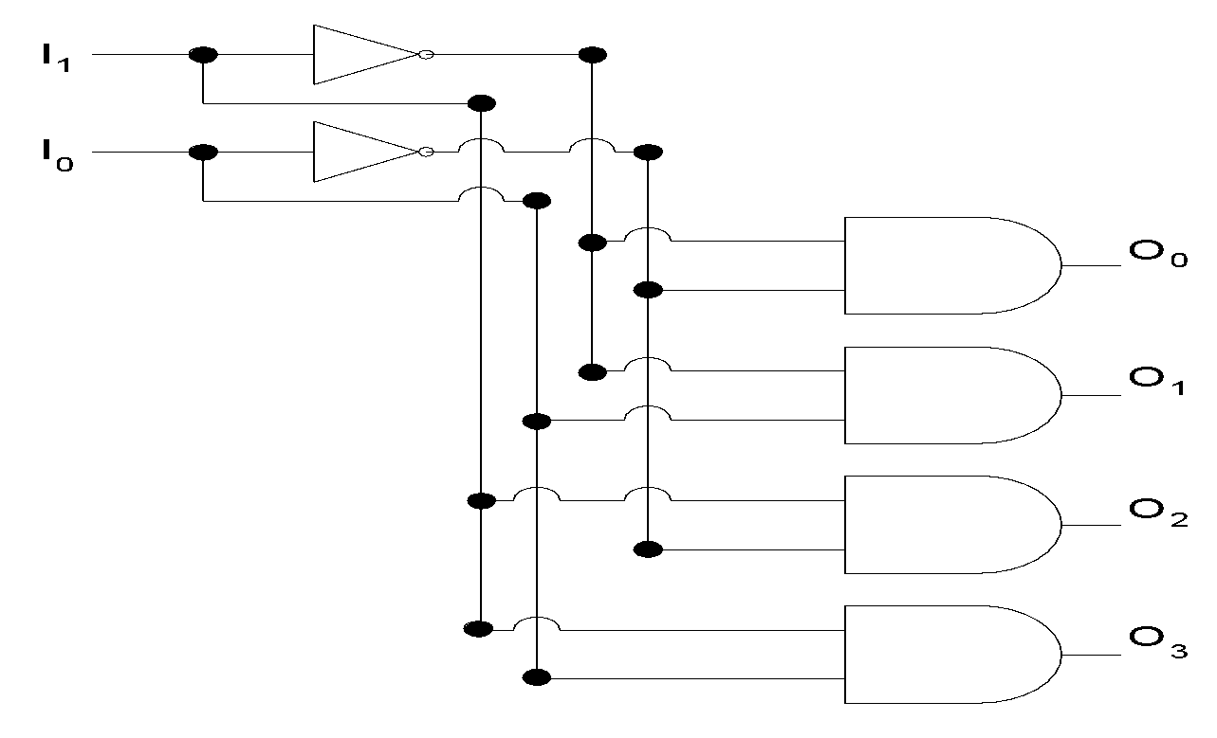
2-to-4 Decoder

Slide 13
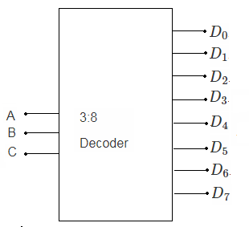
BLOCK DIAGRAM (Decoder 3x8)

Slide 14
BLOCK DIAGRAM (Decoder 3x8)
 |  | A | B | C | D0 | D1 | D2 | D3 | D4 | D5 | D6 | D7
 |  | 0 | 0 | 0
 |  | 0 | 0 | 1
 |  | 0 | 1 | 0
 |  | 0 | 1 | 1
 |  | 1 | 0 | 0
 |  | 1 | 0 | 1
 |  | 1 | 1 | 0
 |  | 1 | 1 | 1

Slide 15
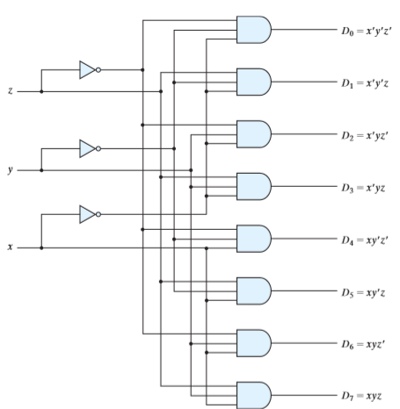
3-to-8 Decoder

Slide 16
4-to-16 Decoder

Slide 17
Full-Adder Function Table
INPUT |  |  | OUTPUT
X | Y | Z | Sum | Carry Out
0 | 0 | 0 | 0 | 0
0 | 0 | 1 | 1 | 0
0 | 1 | 0 | 1 | 0
0 | 1 | 1 | 0 | 1
1 | 0 | 0 | 1 | 0
1 | 0 | 1 | 0 | 1
1 | 1 | 0 | 0 | 1
1 | 1 | 1 | 1 | 1

Slide 18

EXPRESSIONS

Slide 19

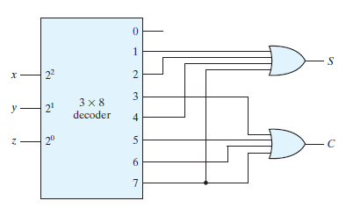
Decoders
Full Adder Using Decoder (Morris)
Notes:
‹#›
10 minutes
24 minutes

Slide 20
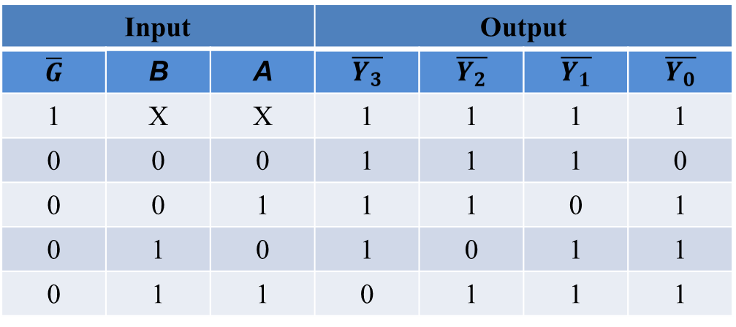
Function Table of 74LS139, 2-to-4 Decoder

Slide 21
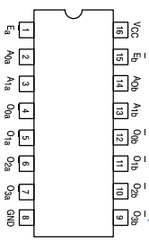
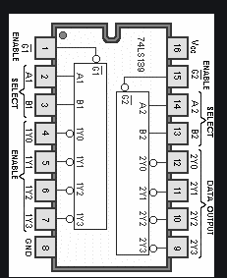
74LS139

Slide 22
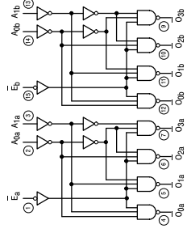
CIRCUIT DIAGRAM 74LS139

Slide 23
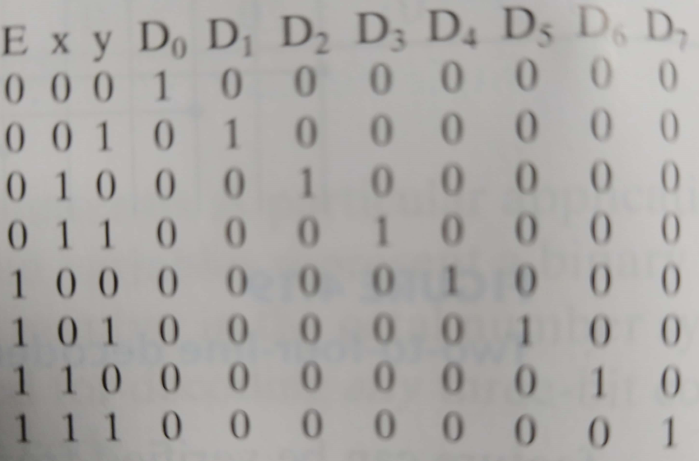
3X8 DECODER BY USING 2X4

Slide 24
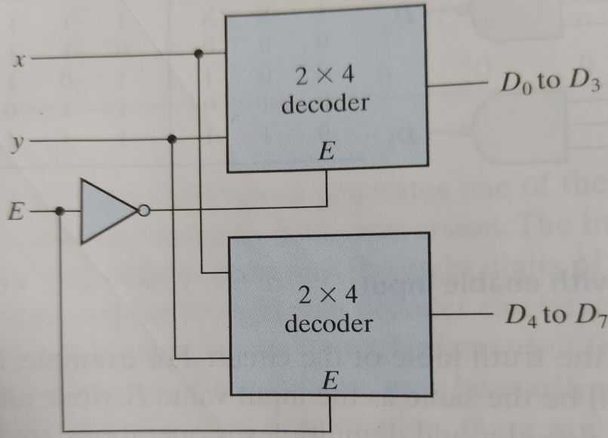
3x8 DECODER BY USING 2X4

Slide 25
4x16 DECODER BY USING 2X4

Slide 26
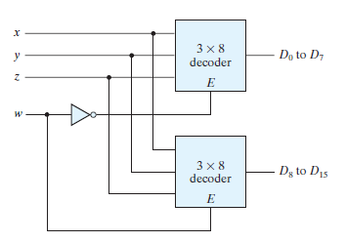
Decoders
4-to-16 Decoder using 3x 8 Decoder (Morris)
Notes:
‹#›
10 minutes
24 minutes

Slide 27
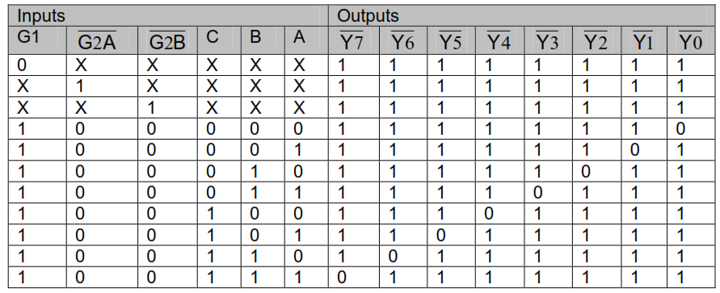
Decoders
74X138 3-to-8 Decoder
Notes:
‹#›
10 minutes
24 minutes

Slide 28
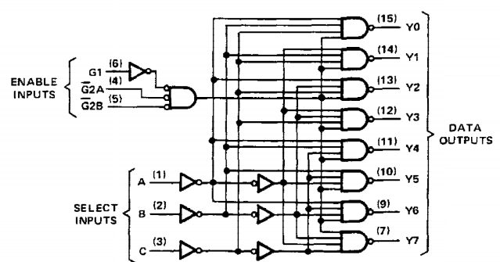
74X138 3-to-8 Decoder
Notes:
‹#›
4 minutes
28 minutes

Slide 29

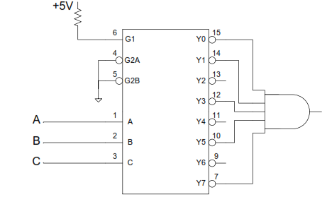
Decoders
Implementing POS
Notes:
‹#›
4 minutes
28 minutes

Slide 30
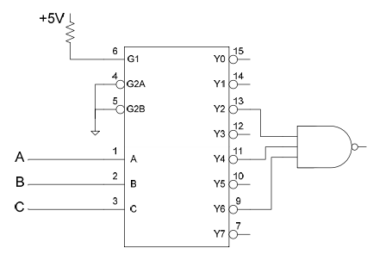
Decoders
Implementing SOP
Notes:
‹#›
4 minutes
28 minutes

Slide 31
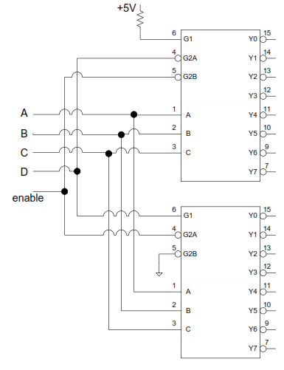
Decoders
4-to-16 Decoder using two 74LS139,3-to-8 Decoder
Notes:
‹#›
10 minutes
24 minutes

Slide 32
Decoders
BCD to 7-Segment Decoder
MSI BCD-7-Segment Decoder 74LS47
Notes:
‹#›
4 minutes
28 minutes

Slide 33
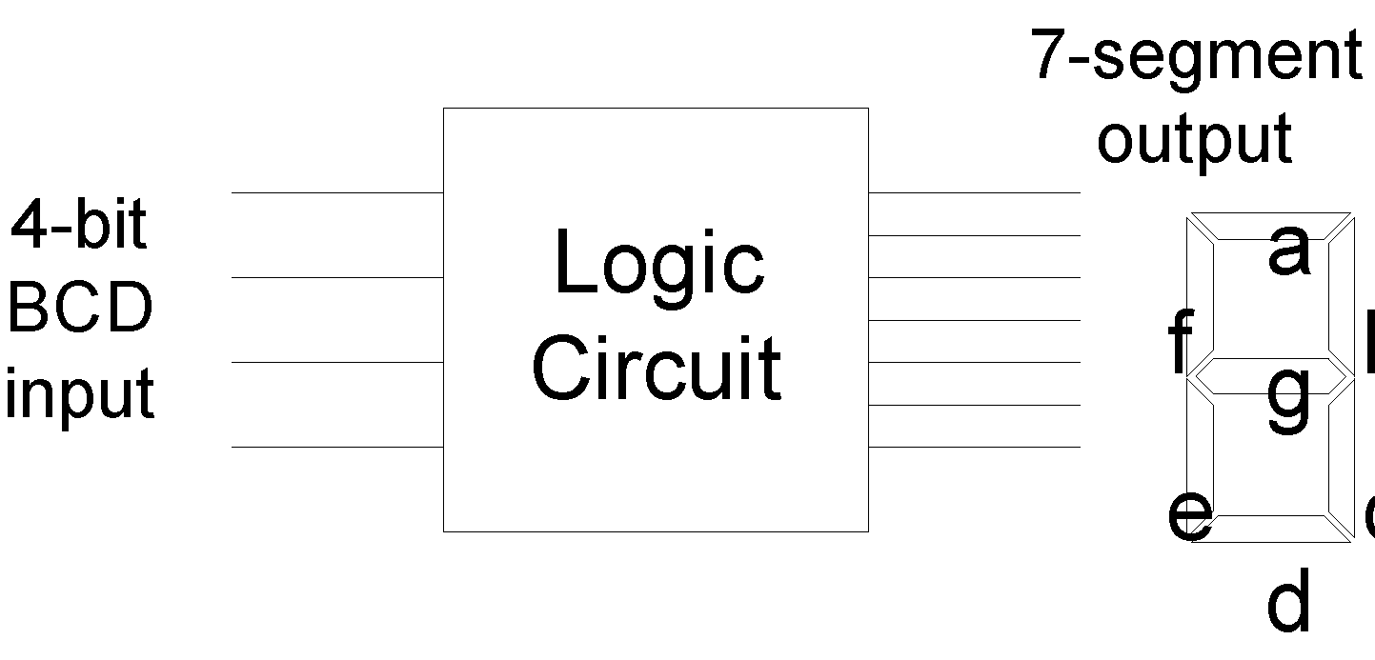
BCD to 7-Segment Decoder

Slide 34
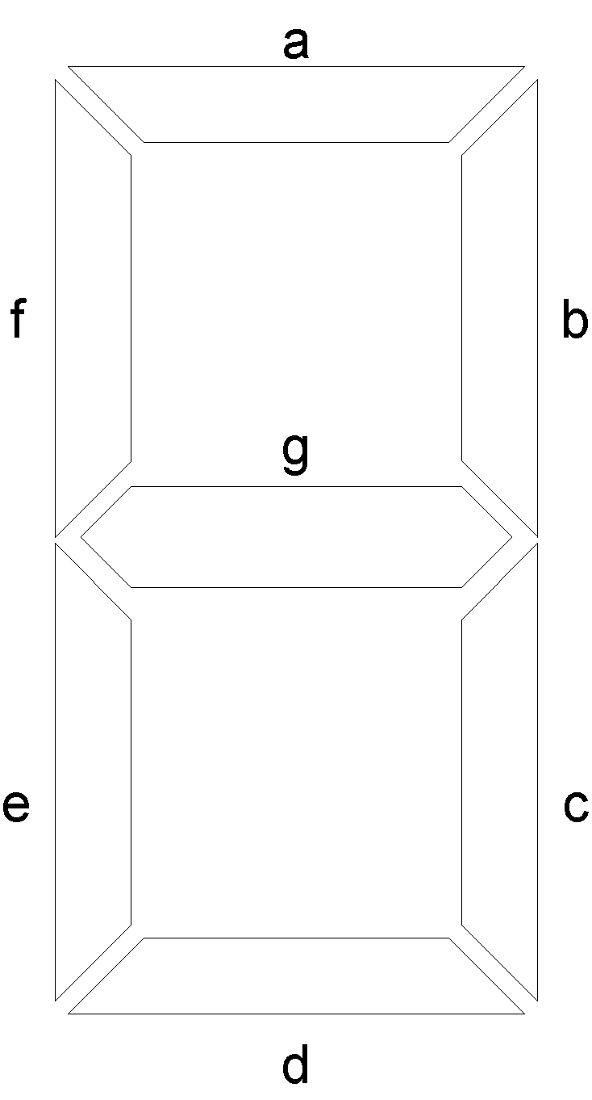
7-Segment Display
Notes:
‹#›
7-Segment display is shaped like the number 8
It has 7-segments that can be lit in different combinations to display any digit between 0 to 9.
The 7-segments are identified by segment numbers a, b, c, d, e, f and g.
The three horizontal segments starting from the top are a, g and f respectively
The two vertical segments on the right side are segments b and c
The two vertical segments on the left side are segments f and e
To display the numbers 0 to 9 different set of segments are turned on
0 a, b, c, d, e, f
1 b, c
2 a, b, d, e, g
3 a, b, c, d, g
4 b, c, f, g
5 a, c, d, f, g
6 a, c, d, e, f, g
7 a, b, c
8 a, b, c, d, e, f, g
9 a, b, c, d, f, g
The segment a, for example is turned on when numbers 0, 2, 3, 5, 6, 7 and 8 are displayed
The segment d, for example is turned on when the numbers 0, 2, 3, 5, 6 and 8 re displayed.
Similarly different sets of segments are selected to display different digits.
The 7-segment display circuit basically can be considered to be 7 different circuits having 4 inputs and 1 output
The 4-bit input of the circuit accepts BCD numbers and the output controls a single segment.
Before implementing the 7 circuits, function tables for each of the 7 circuits have to be prepared.

Slide 35
7-Segment Display
 | A | B | C | D | a | b | c | d | e | f | g
0 | 0 | 0 | 0 | 0
1 | 0 | 0 | 0 | 1
2 | 0 | 0 | 1 | 0
3 | 0 | 0 | 1 | 1
4 | 0 | 1 | 0 | 0
5 | 0 | 1 | 0 | 1
6 | 0 | 1 | 1 | 0
7 | 0 | 1 | 1 | 1
8 | 1 | 0 | 0 | 0
9 | 1 | 0 | 0 | 1
10 | 1 | 0 | 1 | 0
11 | 1 | 0 | 1 | 1
12 | 1 | 1 | 0 | 0
13 | 1 | 1 | 0 | 1
14 | 1 | 1 | 1 | 0
15 | 1 | 1 | 1 | 1
Notes:
‹#›
7-Segment display is shaped like the number 8
It has 7-segments that can be lit in different combinations to display any digit between 0 to 9.
The 7-segments are identified by segment numbers a, b, c, d, e, f and g.
The three horizontal segments starting from the top are a, g and f respectively
The two vertical segments on the right side are segments b and c
The two vertical segments on the left side are segments f and e
To display the numbers 0 to 9 different set of segments are turned on
0 a, b, c, d, e, f
1 b, c
2 a, b, d, e, g
3 a, b, c, d, g
4 b, c, f, g
5 a, c, d, f, g
6 a, c, d, e, f, g
7 a, b, c
8 a, b, c, d, e, f, g
9 a, b, c, d, f, g
The segment a, for example is turned on when numbers 0, 2, 3, 5, 6, 7 and 8 are displayed
The segment d, for example is turned on when the numbers 0, 2, 3, 5, 6 and 8 re displayed.
Similarly different sets of segments are selected to display different digits.
The 7-segment display circuit basically can be considered to be 7 different circuits having 4 inputs and 1 output
The 4-bit input of the circuit accepts BCD numbers and the output controls a single segment.
Before implementing the 7 circuits, function tables for each of the 7 circuits have to be prepared.

Slide 36
7-Segment Display
 | A | B | C | D | a | b | c | d | e | f | g
0 | 0 | 0 | 0 | 0 | 1 | 1 | 1 | 1 | 1 | 1 | 0
1 | 0 | 0 | 0 | 1 | 0 | 1 | 1 | 0 | 0 | 0 | 0
2 | 0 | 0 | 1 | 0 | 1 | 1 | 0 | 1 | 1 | 0 | 1
3 | 0 | 0 | 1 | 1 | 1 | 1 | 1 | 1 | 0 | 0 | 1
4 | 0 | 1 | 0 | 0 | 0 | 1 | 1 | 0 | 0 | 1 | 1
5 | 0 | 1 | 0 | 1 | 1 | 0 | 1 | 1 | 0 | 1 | 1
6 | 0 | 1 | 1 | 0 | 1 | 0 | 1 | 1 | 1 | 1 | 1
7 | 0 | 1 | 1 | 1 | 1 | 1 | 1 | 0 | 0 | 0 | 0
8 | 1 | 0 | 0 | 0 | 1 | 1 | 1 | 1 | 1 | 1 | 1
9 | 1 | 0 | 0 | 1 | 1 | 1 | 1 | 0 | 0 | 1 | 1
10 | 1 | 0 | 1 | 0 | X | X | X | X | X | X | X
11 | 1 | 0 | 1 | 1 | X | X | X | X | X | X | X
12 | 1 | 1 | 0 | 0 | X | X | X | X | X | X | X
13 | 1 | 1 | 0 | 1 | X | X | X | X | X | X | X
14 | 1 | 1 | 1 | 0 | X | X | X | X | X | X | X
15 | 1 | 1 | 1 | 1 | X | X | X | X | X | X | X
Notes:
‹#›
7-Segment display is shaped like the number 8
It has 7-segments that can be lit in different combinations to display any digit between 0 to 9.
The 7-segments are identified by segment numbers a, b, c, d, e, f and g.
The three horizontal segments starting from the top are a, g and f respectively
The two vertical segments on the right side are segments b and c
The two vertical segments on the left side are segments f and e
To display the numbers 0 to 9 different set of segments are turned on
0 a, b, c, d, e, f
1 b, c
2 a, b, d, e, g
3 a, b, c, d, g
4 b, c, f, g
5 a, c, d, f, g
6 a, c, d, e, f, g
7 a, b, c
8 a, b, c, d, e, f, g
9 a, b, c, d, f, g
The segment a, for example is turned on when numbers 0, 2, 3, 5, 6, 7 and 8 are displayed
The segment d, for example is turned on when the numbers 0, 2, 3, 5, 6 and 8 re displayed.
Similarly different sets of segments are selected to display different digits.
The 7-segment display circuit basically can be considered to be 7 different circuits having 4 inputs and 1 output
The 4-bit input of the circuit accepts BCD numbers and the output controls a single segment.
Before implementing the 7 circuits, function tables for each of the 7 circuits have to be prepared.

Slide 37
Function Table for Segment ‘a’
Inputs |  |  |  | Output
A | B | C | D | a
0 | 0 | 0 | 0 | 1
0 | 0 | 0 | 1 | 0
0 | 0 | 1 | 0 | 1
0 | 0 | 1 | 1 | 1
0 | 1 | 0 | 0 | 0
0 | 1 | 0 | 1 | 1
0 | 1 | 1 | 0 | 1
0 | 1 | 1 | 1 | 1
Inputs |  |  |  | Output
A | B | C | D | a
1 | 0 | 0 | 0 | 1
1 | 0 | 0 | 1 | 1
1 | 0 | 1 | 0 | X
1 | 0 | 1 | 1 | X
1 | 1 | 0 | 0 | X
1 | 1 | 0 | 1 | X
1 | 1 | 1 | 0 | X
1 | 1 | 1 | 1 | X

Slide 38
Function Table for Segment ‘b’
Inputs |  |  |  | Output
A | B | C | D | b
0 | 0 | 0 | 0 | 1
0 | 0 | 0 | 1 | 1
0 | 0 | 1 | 0 | 1
0 | 0 | 1 | 1 | 1
0 | 1 | 0 | 0 | 1
0 | 1 | 0 | 1 | 0
0 | 1 | 1 | 0 | 0
0 | 1 | 1 | 1 | 1
Inputs |  |  |  | Output
A | B | C | D | b
1 | 0 | 0 | 0 | 1
1 | 0 | 0 | 1 | 1
1 | 0 | 1 | 0 | X
1 | 0 | 1 | 1 | X
1 | 1 | 0 | 0 | X
1 | 1 | 0 | 1 | X
1 | 1 | 1 | 0 | X
1 | 1 | 1 | 1 | X

Slide 39
Function Table for Segment ‘c’
Inputs |  |  |  | Output
A | B | C | D | c
0 | 0 | 0 | 0 | 1
0 | 0 | 0 | 1 | 1
0 | 0 | 1 | 0 | 0
0 | 0 | 1 | 1 | 1
0 | 1 | 0 | 0 | 1
0 | 1 | 0 | 1 | 1
0 | 1 | 1 | 0 | 1
0 | 1 | 1 | 1 | 1
Inputs |  |  |  | Output
A | B | C | D | c
1 | 0 | 0 | 0 | 1
1 | 0 | 0 | 1 | 1
1 | 0 | 1 | 0 | X
1 | 0 | 1 | 1 | X
1 | 1 | 0 | 0 | X
1 | 1 | 0 | 1 | X
1 | 1 | 1 | 0 | X
1 | 1 | 1 | 1 | X

Slide 40
Function Table for Segment ‘d’
Inputs |  |  |  | Output
A | B | C | D | d
0 | 0 | 0 | 0 | 1
0 | 0 | 0 | 1 | 0
0 | 0 | 1 | 0 | 1
0 | 0 | 1 | 1 | 1
0 | 1 | 0 | 0 | 0
0 | 1 | 0 | 1 | 1
0 | 1 | 1 | 0 | 1
0 | 1 | 1 | 1 | 0
Inputs |  |  |  | Output
A | B | C | D | d
1 | 0 | 0 | 0 | 1
1 | 0 | 0 | 1 | 1
1 | 0 | 1 | 0 | X
1 | 0 | 1 | 1 | X
1 | 1 | 0 | 0 | X
1 | 1 | 0 | 1 | X
1 | 1 | 1 | 0 | X
1 | 1 | 1 | 1 | X

Slide 41
Function Table for Segment ‘e’
Inputs |  |  |  | Output
A | B | C | D | e
0 | 0 | 0 | 0 | 1
0 | 0 | 0 | 1 | 0
0 | 0 | 1 | 0 | 1
0 | 0 | 1 | 1 | 0
0 | 1 | 0 | 0 | 0
0 | 1 | 0 | 1 | 0
0 | 1 | 1 | 0 | 1
0 | 1 | 1 | 1 | 0
Inputs |  |  |  | Output
A | B | C | D | e
1 | 0 | 0 | 0 | 1
1 | 0 | 0 | 1 | 0
1 | 0 | 1 | 0 | X
1 | 0 | 1 | 1 | X
1 | 1 | 0 | 0 | X
1 | 1 | 0 | 1 | X
1 | 1 | 1 | 0 | X
1 | 1 | 1 | 1 | X

Slide 42
Function Table for Segment ‘f’
Inputs |  |  |  | Output
A | B | C | D | f
0 | 0 | 0 | 0 | 1
0 | 0 | 0 | 1 | 0
0 | 0 | 1 | 0 | 0
0 | 0 | 1 | 1 | 0
0 | 1 | 0 | 0 | 1
0 | 1 | 0 | 1 | 1
0 | 1 | 1 | 0 | 1
0 | 1 | 1 | 1 | 0
Inputs |  |  |  | Output
A | B | C | D | f
1 | 0 | 0 | 0 | 1
1 | 0 | 0 | 1 | 1
1 | 0 | 1 | 0 | X
1 | 0 | 1 | 1 | X
1 | 1 | 0 | 0 | X
1 | 1 | 0 | 1 | X
1 | 1 | 1 | 0 | X
1 | 1 | 1 | 1 | X

Slide 43
Function Table for Segment ‘g’
Inputs |  |  |  | Output
A | B | C | D | g
0 | 0 | 0 | 0 | 0
0 | 0 | 0 | 1 | 0
0 | 0 | 1 | 0 | 1
0 | 0 | 1 | 1 | 1
0 | 1 | 0 | 0 | 1
0 | 1 | 0 | 1 | 1
0 | 1 | 1 | 0 | 1
0 | 1 | 1 | 1 | 0
Inputs |  |  |  | Output
A | B | C | D | g
1 | 0 | 0 | 0 | 1
1 | 0 | 0 | 1 | 1
1 | 0 | 1 | 0 | X
1 | 0 | 1 | 1 | X
1 | 1 | 0 | 0 | X
1 | 1 | 0 | 1 | X
1 | 1 | 1 | 0 | X
1 | 1 | 1 | 1 | X

Slide 44
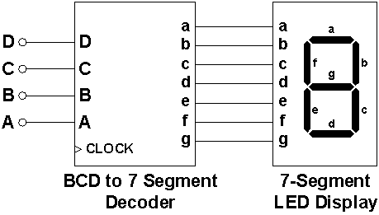
BCD to 7 Segment Decoder

Slide 45
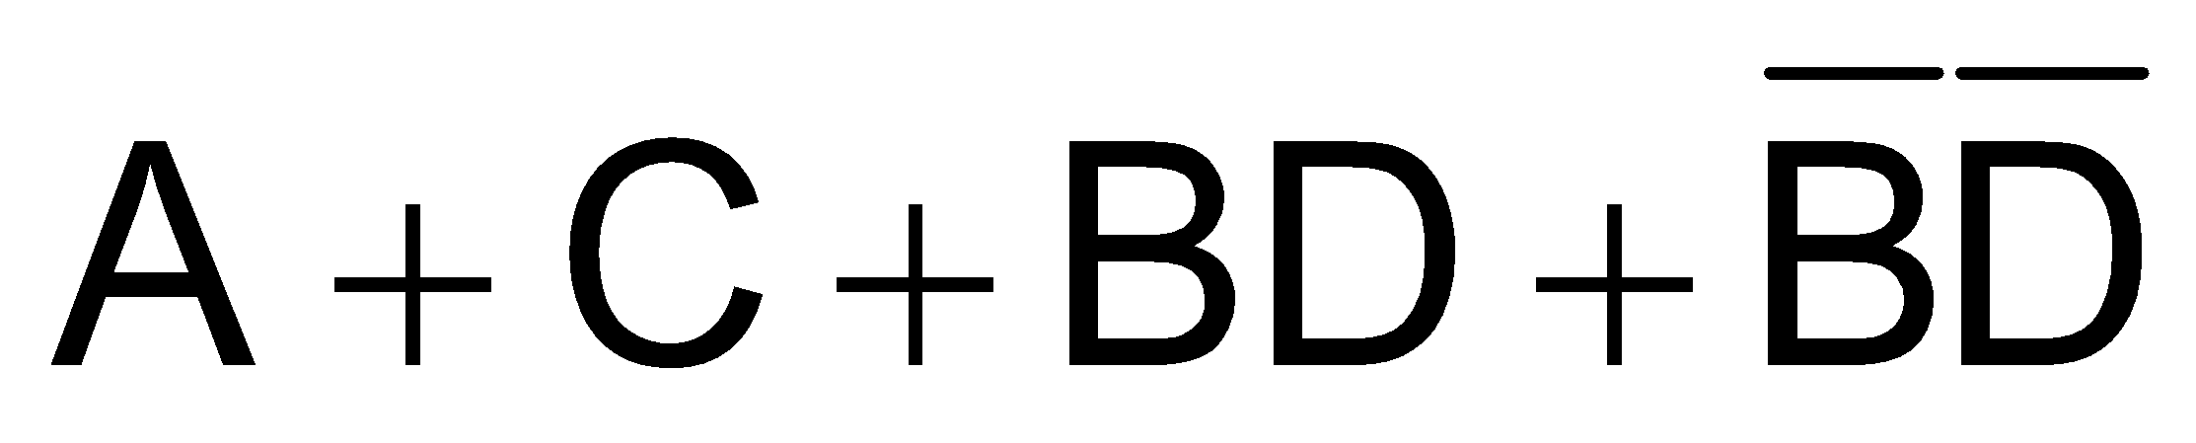
Karnaugh Map for Segment ‘a’
AB\CD | 00 | 01 | 11 | 10
00 | 1 | 0 | 1 | 1
01 | 0 | 1 | 1 | 1
11 | x | x | x | x
10 | 1 | 1 | x | x
Notes:
‹#›

Slide 46
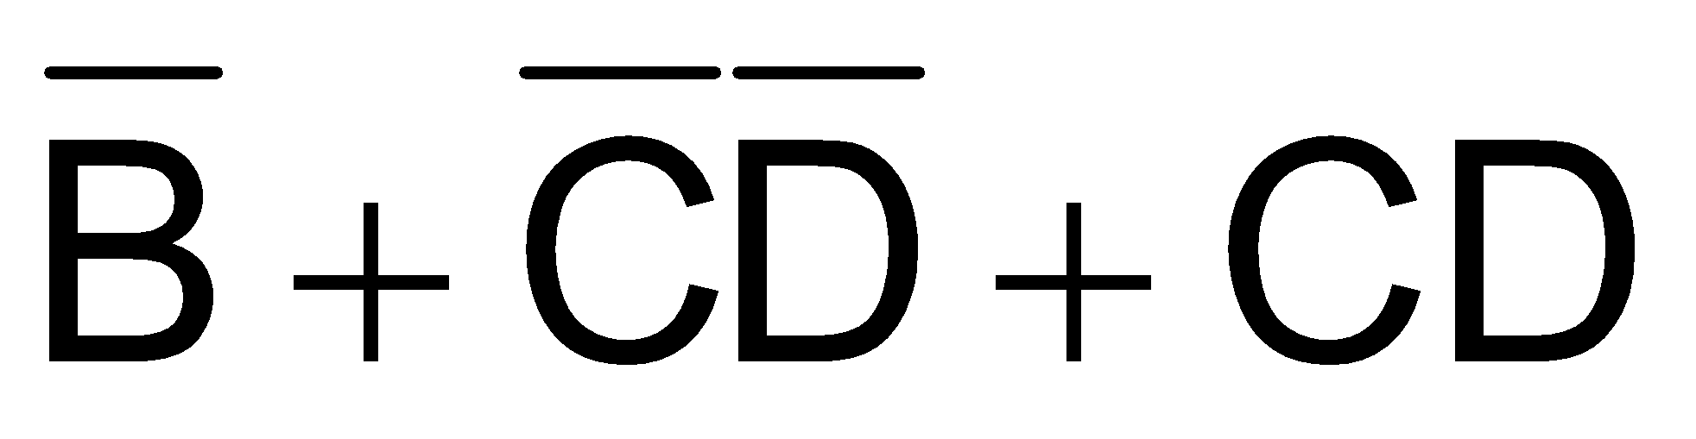
Karnaugh Map for Segment ‘b’
AB\CD | 00 | 01 | 11 | 10
00 | 1 | 1 | 1 | 1
01 | 1 | 0 | 1 | 0
11 | x | x | x | x
10 | 1 | 1 | x | x
Notes:
‹#›

Slide 47
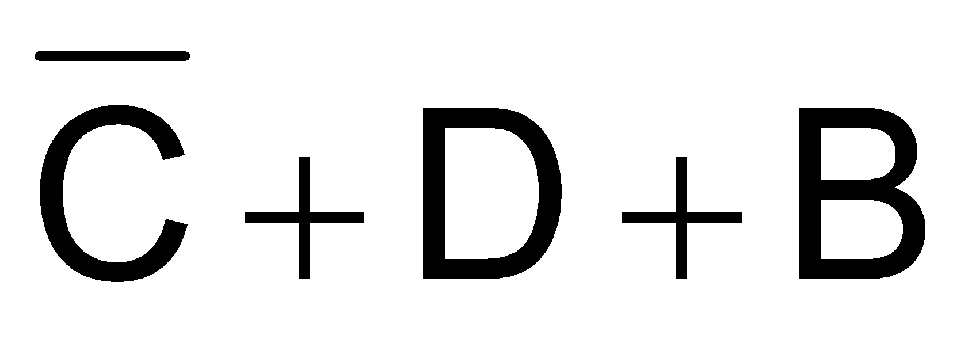
Karnaugh Map for Segment ‘c’
AB\CD | 00 | 01 | 11 | 10
00 | 1 | 1 | 1 | 0
01 | 1 | 1 | 1 | 1
11 | x | x | x | x
10 | 1 | 1 | x | x
Notes:
‹#›

Slide 48

Karnaugh Map for Segment ‘d’
AB\CD | 00 | 01 | 11 | 10
00 | 1 | 0 | 1 | 1
01 | 0 | 1 | 0 | 1
11 | x | x | x | x
10 | 1 | 1 | x | x
Notes:
‹#›

Slide 49

Karnaugh Map for Segment ‘e’
AB\CD | 00 | 01 | 11 | 10
00 | 1 | 0 | 0 | 1
01 | 0 | 0 | 0 | 1
11 | x | x | x | x
10 | 1 | 0 | x | x
Notes:
‹#›

Slide 50
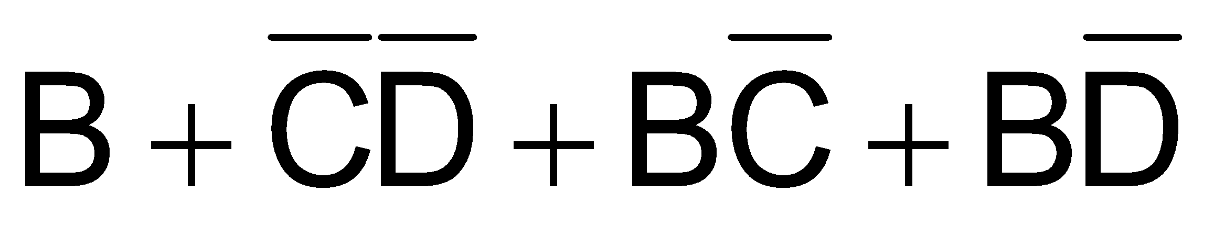
Karnaugh Map for Segment ‘f’
AB\CD | 00 | 01 | 11 | 10
00 | 1 | 0 | 0 | 0
01 | 1 | 1 | 0 | 1
11 | x | x | x | x
10 | 1 | 1 | x | x
Notes:
‹#›

Slide 51

Karnaugh Map for Segment ‘g’
AB\CD | 00 | 01 | 11 | 10
00 | 0 | 0 | 1 | 1
01 | 1 | 1 | 0 | 1
11 | x | x | x | x
10 | 1 | 1 | x | x
Notes:
‹#›

Slide 52
7-Segment Circuit

Slide 53
Encoders
An Encoder is functional device performs an operation opposite of the decoder.
Binary Encoders
Simplest of the encoders are 2^{n}-to- n Encoder
Notes:
‹#›
8 minutes
36 minutes

Slide 54
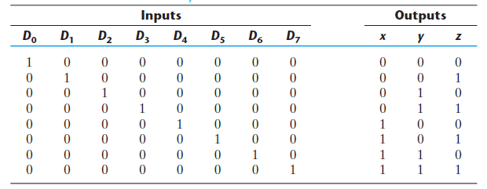
Encoders
Binary Encoders
Notes:
‹#›
8 minutes
36 minutes

Slide 55

Encoders
Binary Encoders
Notes:
‹#›
8 minutes
36 minutes

Slide 56
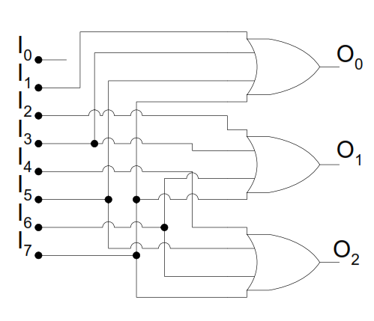
Encoders
Binary Encoders
Notes:
‹#›
8 minutes
36 minutes

Slide 57
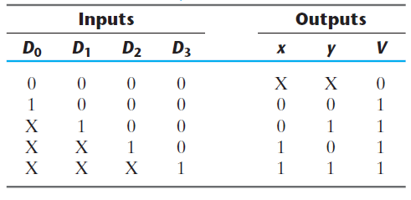
Encoders
Priority Encoders
Notes:
‹#›
8 minutes
36 minutes

Slide 58
Encoders
Priority Encoders
INPUT |  |  |  | OUTPUT |  |  | INPUT |  |  |  | OUTPUT
D0 | D1 | D2 | D3 | x | y | V | D0 | D1 | D2 | D3 | x | y | V
0 | 0 | 0 | 0 |  |  |  | 1 | 0 | 0 | 0
0 | 0 | 0 | 1 |  |  |  | 1 | 0 | 0 | 1
0 | 0 | 1 | 0 |  |  |  | 1 | 0 | 1 | 0
0 | 0 | 1 | 1 |  |  |  | 1 | 0 | 1 | 1
0 | 1 | 0 | 0 |  |  |  | 1 | 1 | 0 | 0
0 | 1 | 0 | 1 |  |  |  | 1 | 1 | 0 | 1
0 | 1 | 1 | 0 |  |  |  | 1 | 1 | 1 | 0
0 | 1 | 1 | 1 |  |  |  | 1 | 1 | 1 | 1
Notes:
‹#›
8 minutes
36 minutes

Slide 59
Encoders
Priority Encoders
INPUT |  |  |  | OUTPUT |  |  | INPUT |  |  |  | OUTPUT
D0 | D1 | D2 | D3 | x | y | V | D0 | D1 | D2 | D3 | x | y | V
0 | 0 | 0 | 0 | X | X | 0 | 1 | 0 | 0 | 0
0 | 0 | 0 | 1 | 1 | 1 | 1 | 1 | 0 | 0 | 1
0 | 0 | 1 | 0 |  |  |  | 1 | 0 | 1 | 0
0 | 0 | 1 | 1 | 1 | 1 | 1 | 1 | 0 | 1 | 1
0 | 1 | 0 | 0 |  |  |  | 1 | 1 | 0 | 0
0 | 1 | 0 | 1 | 1 | 1 | 1 | 1 | 1 | 0 | 1
0 | 1 | 1 | 0 |  |  |  | 1 | 1 | 1 | 0
0 | 1 | 1 | 1 |  |  |  | 1 | 1 | 1 | 1
Notes:
‹#›
8 minutes
36 minutes

Slide 60
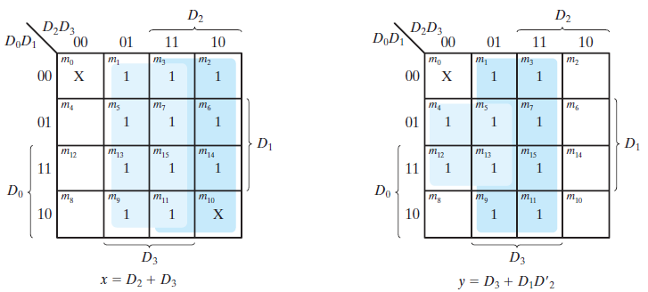
Encoders
Priority Encoders
Notes:
‹#›
8 minutes
36 minutes

Slide 61
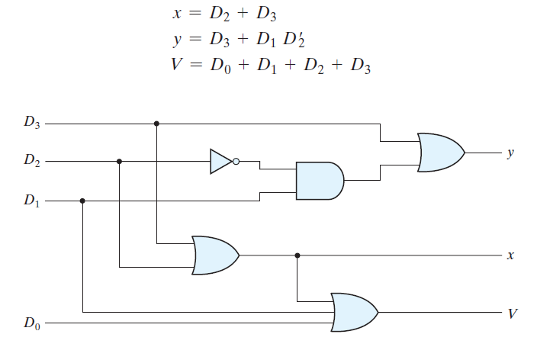
Encoders
Priority Encoders
Notes:
‹#›
8 minutes
36 minutes

Slide 62
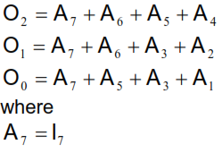
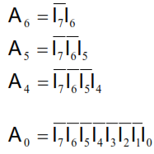
Encoders
Priority Encoders
Notes:
‹#›
8 minutes
36 minutes

Slide 63
Encoders
Priority Encoders
I₀ | I₁ | I₂ | I₃ | I₄ | I₅ | I₆ | I₇ | 0₂ | 0₁ | 0₀
1 | 0 | 0 | 0 | 0 | 0 | 0 | 0 | 0 | 0 | 0
X | 1 | 0 | 0 | 0 | 0 | 0 | 0 | 0 | 0 | 1
X | X | 1 | 0 | 0 | 0 | 0 | 0 | 0 | 1 | 0
X | X | X | 1 | 0 | 0 | 0 | 0 | 0 | 1 | 1
X | X | X | X | 1 | 0 | 0 | 0 | 1 | 0 | 0
X | X | X | X | X | 1 | 0 | 0 | 1 | 0 | 1
X | X | X | X | X | X | 1 | 0 | 1 | 1 | 0
X | X | X | X | X | X | X | 1 | 1 | 1 | 1
Notes:
‹#›
8 minutes
36 minutes

Slide 64
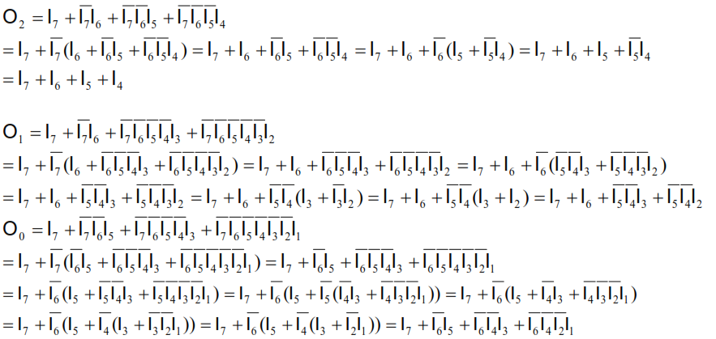
Encoders
Notes:
‹#›
8 minutes
36 minutes

Slide 65
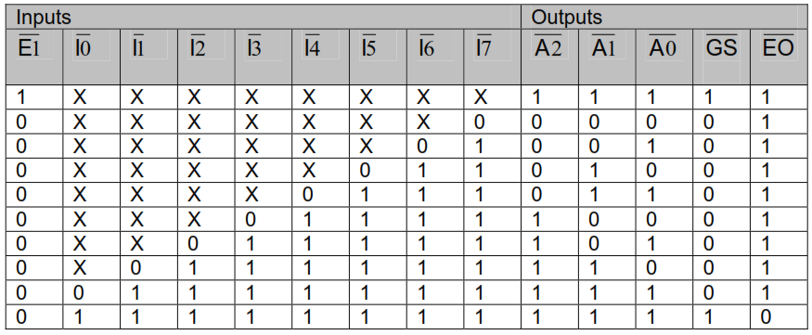
Encoders
Priority Encoders
Notes:
‹#›
8 minutes
36 minutes

Slide 66
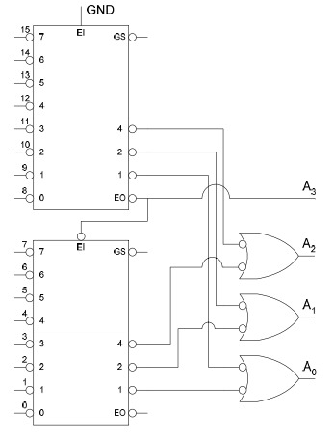
Encoders
Cascading priority Encoders
Notes:
‹#›
8 minutes
36 minutes

Slide 67
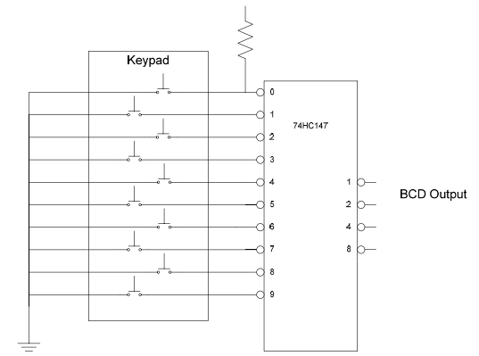
Encoders
Decimal-to-BCD Encoder(74LS147)
Notes:
‹#›
8 minutes
36 minutes

